Slide 1
WEEK 9 - DEMO
ANNIE NGUYEN
January 26, 2018

Slide 2


OUTLINE
Voting System
Login Authorization

Slide 3
Voting System

Slide 4
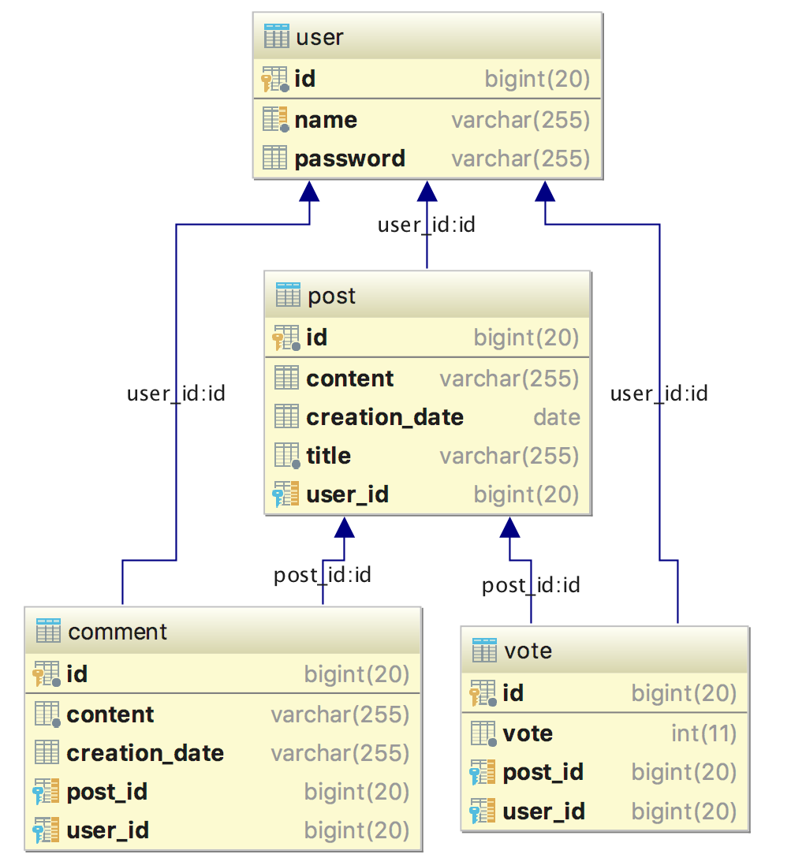
Database Visualization

Slide 5
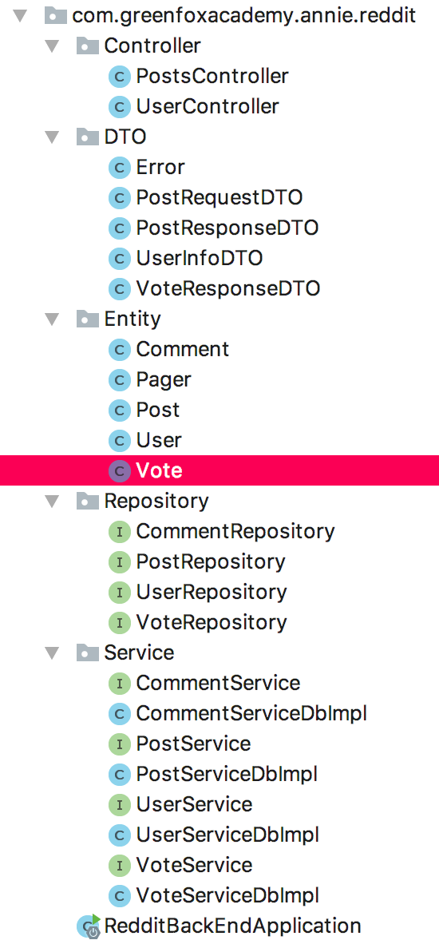
@ManyToOne(fetch= FetchType.LAZY, cascade=CascadeType.MERGE) @JoinColumn(name = "user_id") private User user; @ManyToOne(fetch= FetchType.LAZY, cascade= CascadeType.MERGE) @JoinColumn(name = "post_id") private Post post; private int vote; public Vote(User user, Post post, int vote) { this.user = user; this.post = post; this.vote = vote; }

Slide 6
@PutMapping("/{id}/upvote") public ResponseEntity<?> upvote(@RequestHeader(value ="owner") String owner, @PathVariable(value = "id") long id) { //Find user and post by name and id Vote vote = voteServiceDb.findByPostAndUser(post, user); if(vote == null) { Vote upvote = new Vote(user, post, 1); voteServiceDb.save(upvote); } else if(vote.getVote() == -1) { vote.setVote(1); voteServiceDb.save(vote); } else { post.getVotes().remove(vote); voteServiceDb.delete(vote); } postServiceDb.save(post); return new ResponseEntity<>(new VoteResponseDTO(post, user), HttpStatus.OK); }

Slide 7
Login Authorization

Slide 8
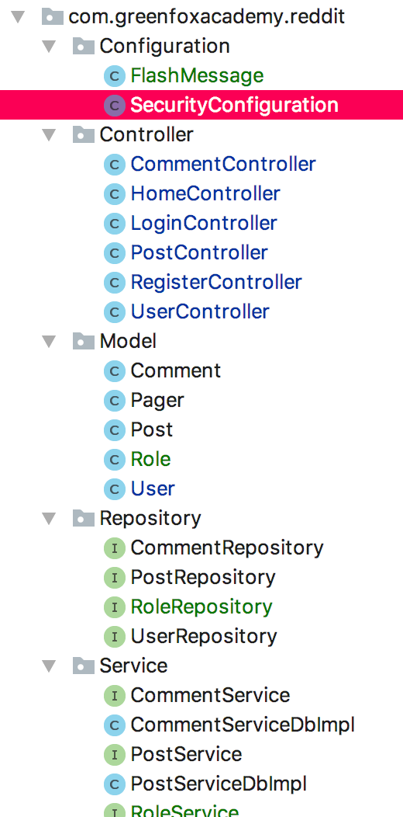
@Configuration @EnableWebSecurity @EnableGlobalMethodSecurity(prePostEnabled=true) public class SecurityConfiguration extends WebSecurityConfigurerAdapter { @Autowired
private final UserServiceDbImpl userService; @Override protected void configure(HttpSecurity http) throws Exception { http .formLogin() .loginPage("/login") .successHandler(loginSuccessHandler()) .failureHandler(loginFailureHandler()) .and().logout() .invalidateHttpSession(true) .logoutSuccessUrl("/login") .and().csrf(); }

Slide 9
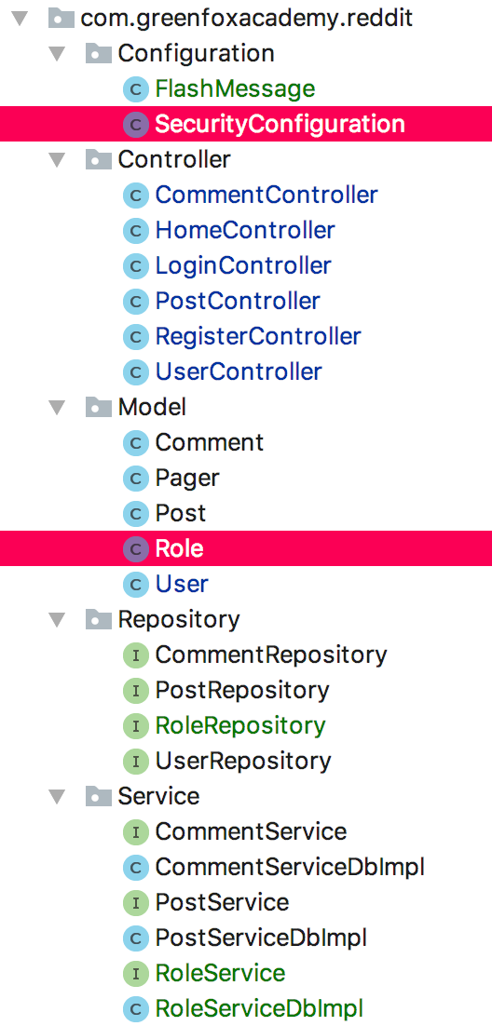
public AuthenticationSuccessHandler loginSuccessHandler() { return (request, response, authentication) -> response.sendRedirect("/home/" + authentication.getName()); }
@Entity @Table public class Role { @Id @GeneratedValue(strategy = GenerationType.IDENTITY) private Long id; private String name;
public Role (String name) { this(); this.name = name; }
//Getter, Setter and Default constructor
}

Slide 10
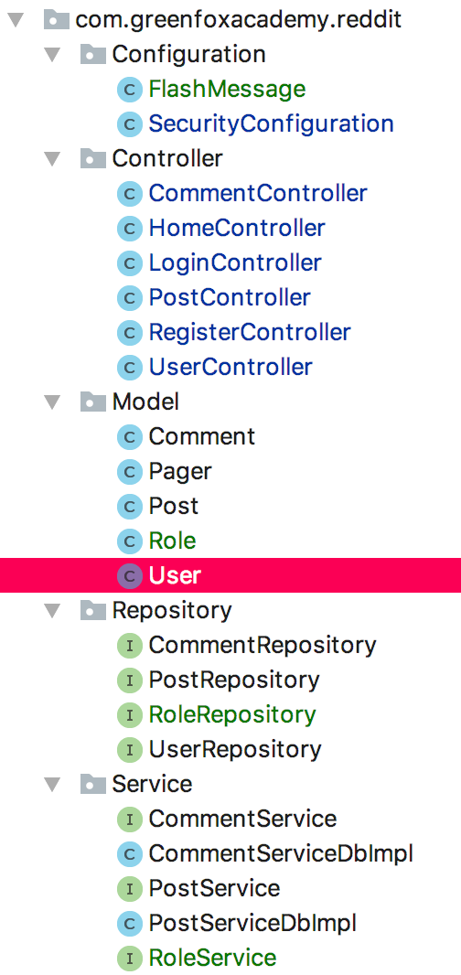
@Entity @Table public class User implements UserDetails {
@Override public Collection<? extends GrantedAuthority> getAuthorities(){ return AuthorityUtils.createAuthorityList(role.getName());
} @Override public String getUsername() { return this.name; } @Override public boolean isAccountNonExpired() { return true; } @Override public boolean isAccountNonLocked() { return true; } @Override public boolean isCredentialsNonExpired() { return true; } @Override public boolean isEnabled() { return enabled; }

Slide 11
home.html importing ThymeLeaf secutiry
<html xmlns:sec="http://www.thymeleaf.org/extras/spring-security" />
<div th:if="${#authentication.name} == ${user.name}">
<!-- -->
</div>
<div th:unless="${#authentication.name} == ${user.name}"> <div class="mycontainer"> <h1>Sorry! You dont have the right to access this page! </h1> <div class="redditor"><a class="btn btn-success" role="button" th:href="@{/login}">Already a Redittor?</a></div> <div class="redditor"><a class="btn btn-warning" role="button"
th:href="@{/register}">If not, Join us</a></div> </div> </div>

Slide 12
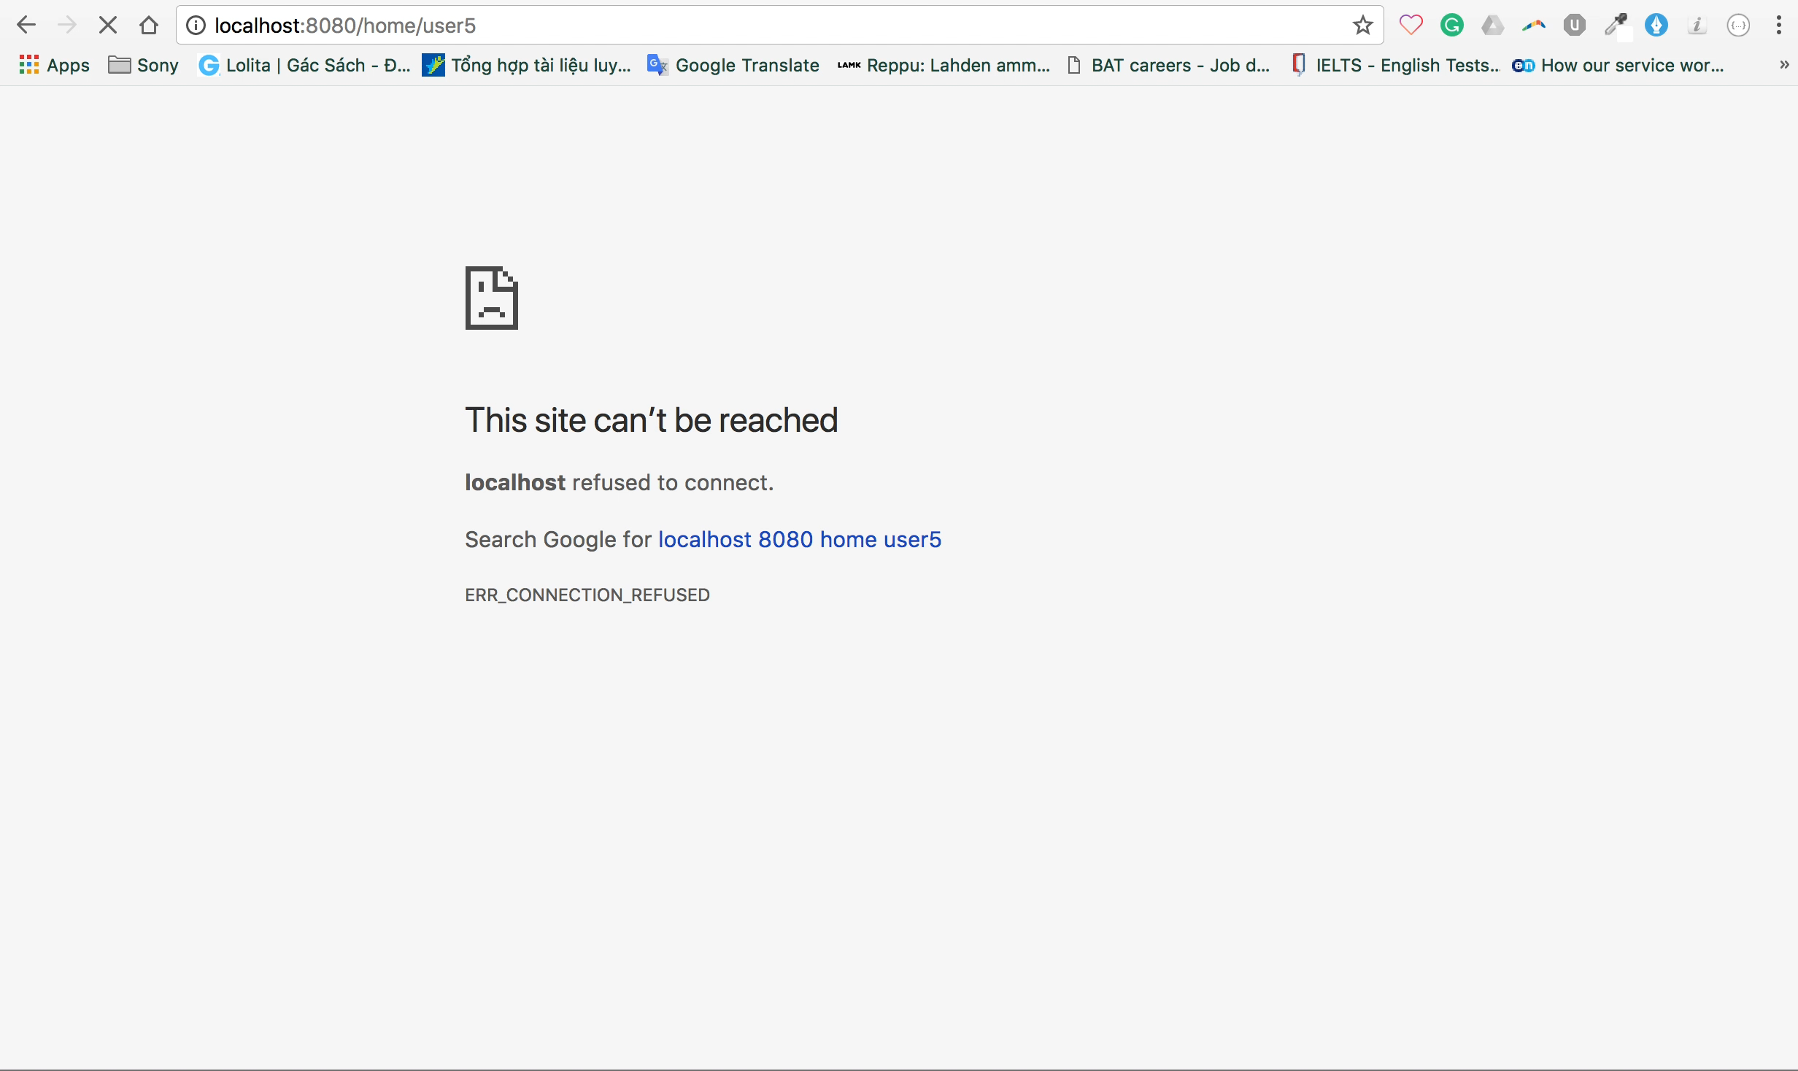

Slide 13
THANK YOU FOR YOUR ATTENTION

